Slide 1
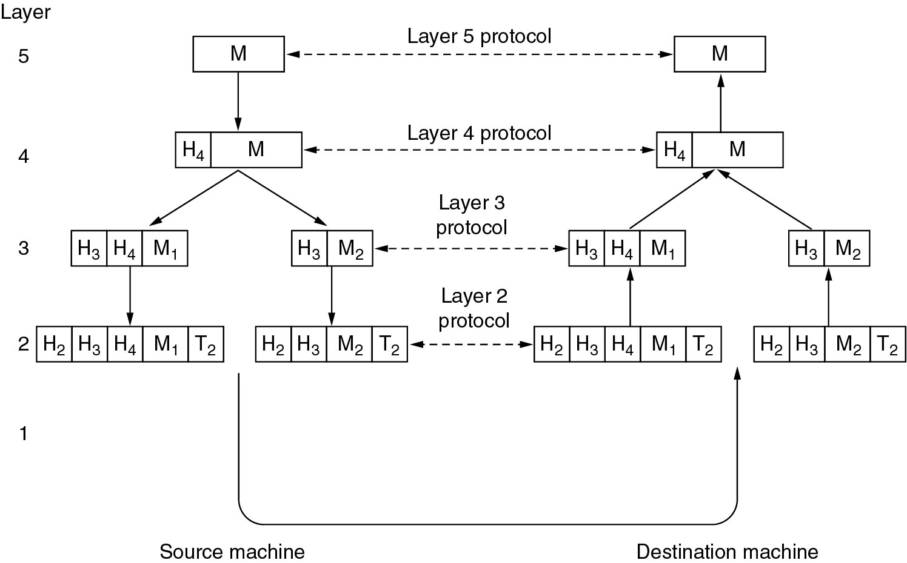
Protocol Hierarchies
Example information flow supporting virtual communication in layer 5

Slide 2
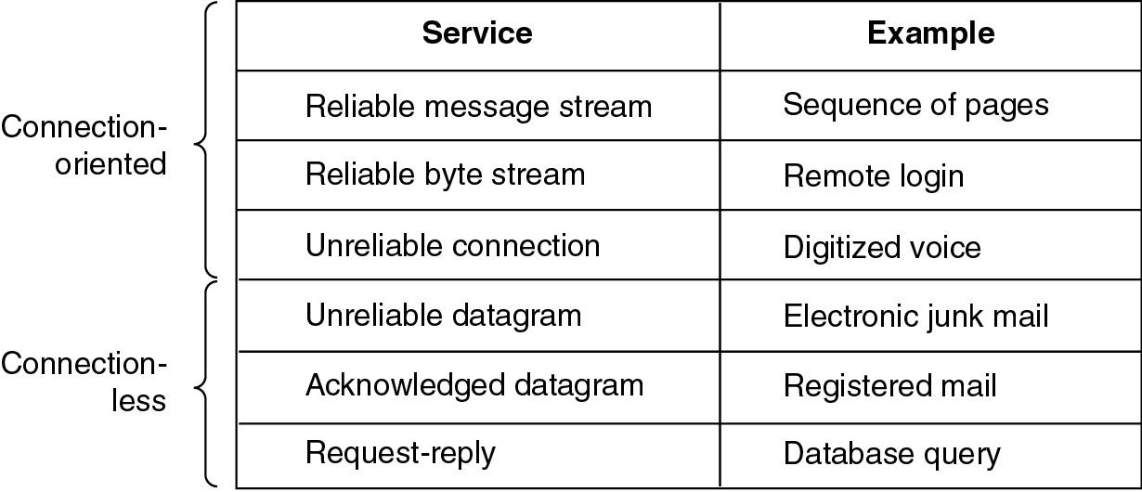
Connection-Oriented and Connectionless Services
Six different types of service

Slide 3
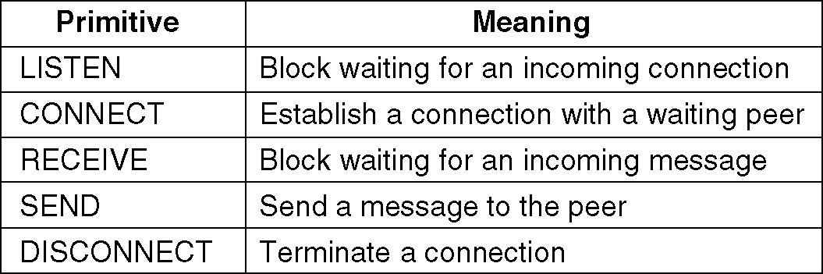
Service Primitives
5 service primitives for implementing a simple connection-oriented service

Slide 4
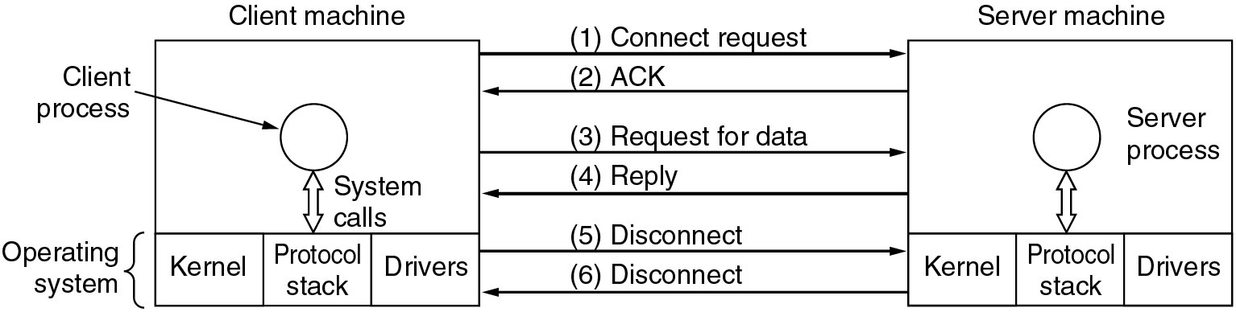
Service Primitives
Packets sent in a simple client-server interaction on a connection-oriented network

Slide 5
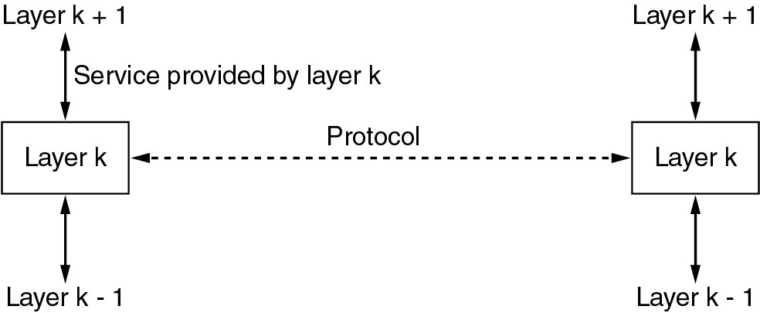
Services to Protocols Relationship
Service: set of operations that a layer provides to the layer above it
Protocol: set of rules governing the format and meaning of frames, packets or messages exchanged by peer entities within a layer

Slide 6
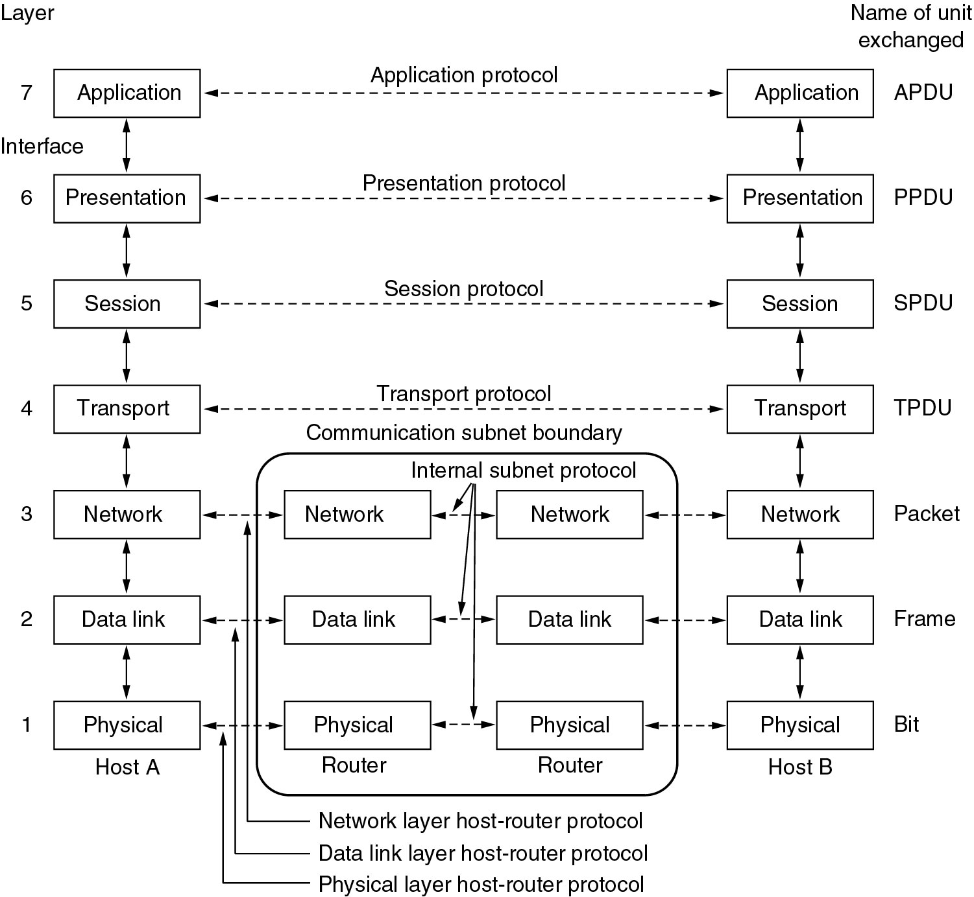
OSI Model

Slide 7
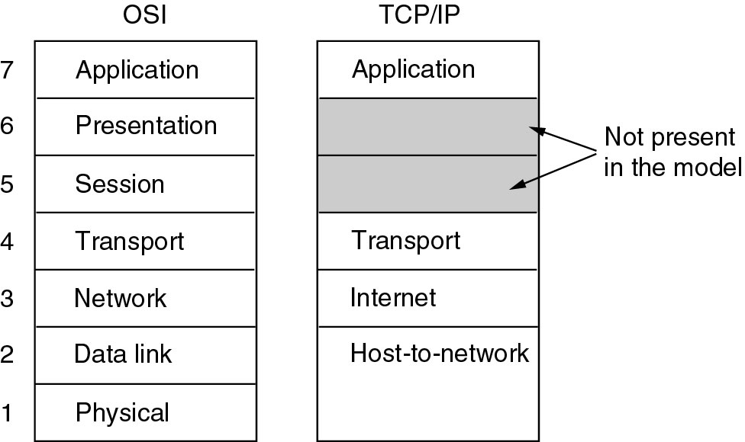
TCP/IP Model

Slide 8
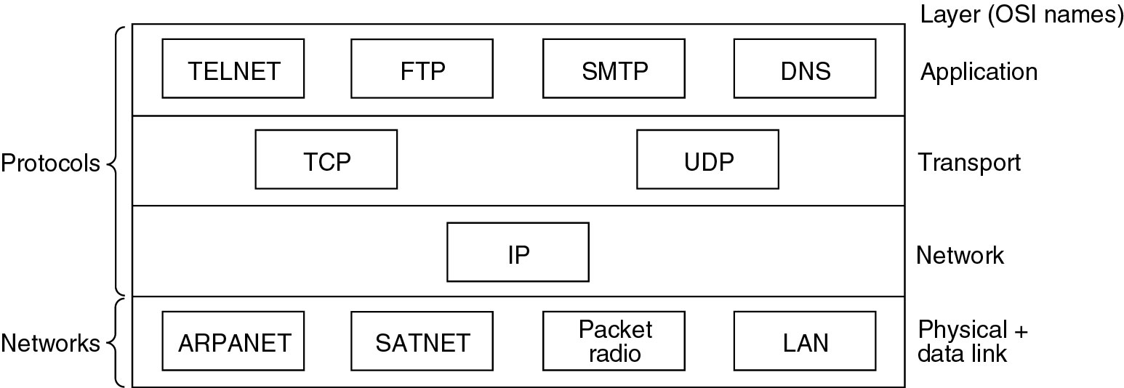
Initial TCP/IP Protocols and Networks

Slide 9
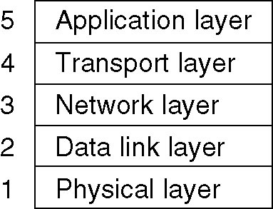
Hybrid Model
The hybrid reference model to be used in this book

Slide 10
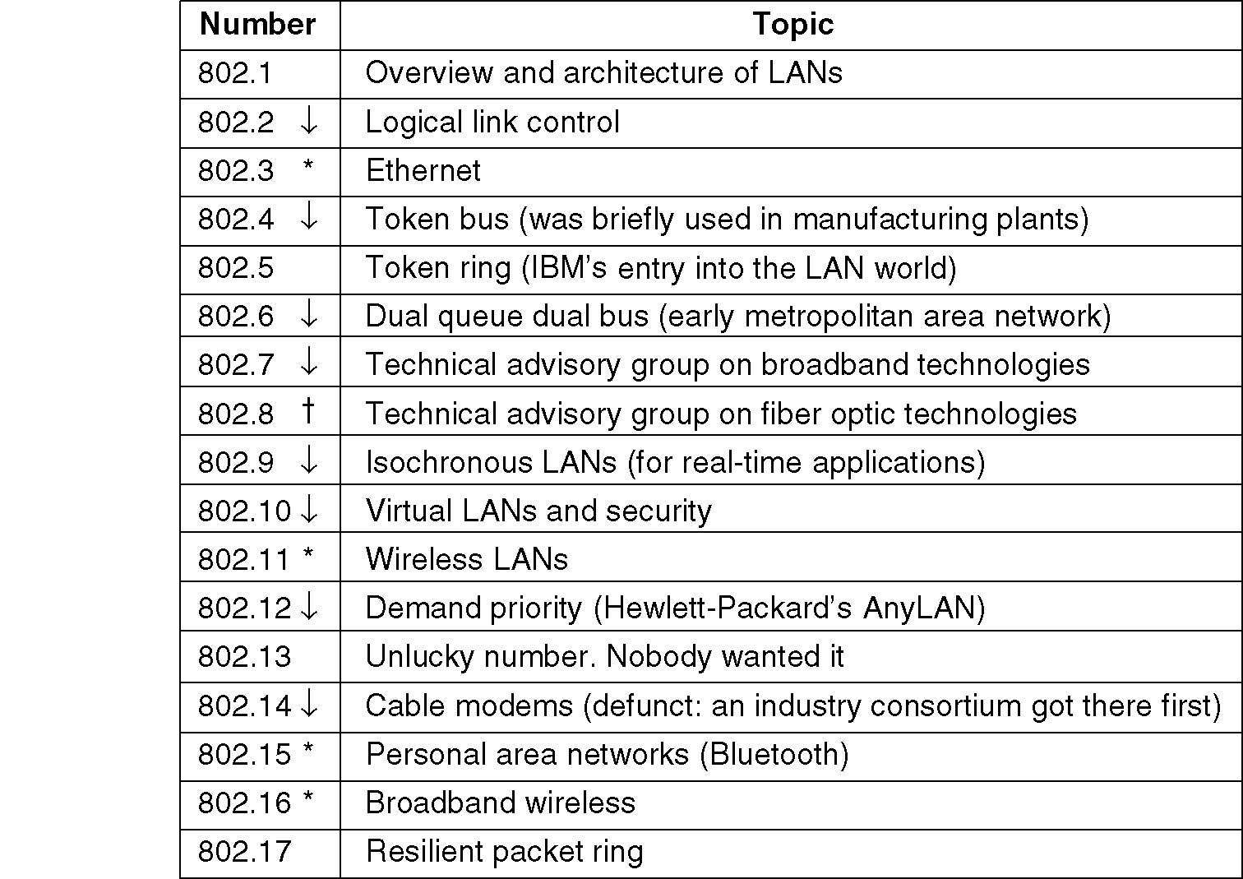
IEEE 802 Standards
The 802 working groups. The important ones are marked with *. The ones marked with ↓ are hibernating. The one marked with † gave up.

Slide 11
Discussion Question
Problem 1.8
  A collection of 5 routers is to be connected in a point-to-point subnet. Between each pair of routers, the designers may put a high-speed line, a medium-speed line, a low-speed line, or no line. If it takes 100 ms of computer time to generate and inspect each topology, how long will it take to inspect all of them to find the one that best matches the expected load?

Slide 12
Discussion Question
Problem 1.11
  What are two reasons for using layered protocols?

